Slide 1
Records identified databases
n=
Scopus= 365
PubMed= 129
Web of Science= 835
Records identified in Scopus
n= 365
Records in English and article type
n=
Scopus= 290
PubMed=
Web of Science=603
Records in English and article type
n=290
Records screened by title
n=
Scopus=147
PubMed=
Web of Science=
Records screened by title
n=147
Records screened by abstract
n=
Scopus=33
PubMed=
Web of Science=
Records screened by abstract
n=33

Slide 2
Records identified databases
n= 741
Scopus= 365 PubMed= 129 Web of Science= 247
Records in English and open access
n= 405
Scopus= 147 PubMed= 122 Web of Science= 136
Duplicates: 144
Records removed the duplicates
n= 261
Removed by title: 142
Screened by titles
n=119
Removed by abstract: 80
Screened by abstracts
n=34
Removed by full-text: 2
Final included studies
n=32

Slide 3
Records identified in databases
n= 741
Scopus= 365 PubMed= 129 Web of Science= 247
Records in English and open access
n= 405
Scopus= 147 PubMed= 122 Web of Science= 136
Duplicates: 144
Records after removing duplicates
n= 261
Removed by title: 142
Screened by titles
n=119
Removed by abstract: 80
Screened by abstracts
n=34
Removed by full-text: 2
Final included studies
n=32
Notes:
https://www.webofscience.com/wos/alldb/summary/3348b4f9-3022-408c-93bd-6bcc53901185-011fcecaae/relevance/1

Slide 4
Records identified in databases
n= 2391
Scopus= 423 PubMed= 160 Web of Science= 1808
Records in English and open access
n= 835
Scopus= 157 PubMed= 87 Web of Science= 591
Duplicates: 229
Records after removing duplicates
n= 606
Removed by title: 480
Screened by titles
n=126
Removed by abstract:
67
Screened by abstracts
n=59
Removed by full-text:
Final included studies
n=

Slide 5
Records identified in databases
n= 2391
Scopus= 423 PubMed= 160 WoS= 1808
Records identified in databases
n= 741
Scopus= 365 PubMed= 129 WoS= 247
Records in English and open access
n= 835
Scopus= 157 PubMed= 87 WoS= 591
Duplicates: 229
Records in English and open access
n= 405
Scopus= 147 PubMed= 122 WoS= 136
Duplicates: 144
Records after removing duplicates
n= 606
Removed by title: 480
Records after removing duplicates
n= 261
Removed by title: 142
Screened by titles
n=126
Removed by abstract:
67
Screened by titles
n=119
Removed by abstract: 80
Screened by abstracts
n=59
Removed by full-text:
Screened by abstracts
n=34
Removed by full-text: 2
Final included studies
n=
Final included studies
n=32

Slide 6
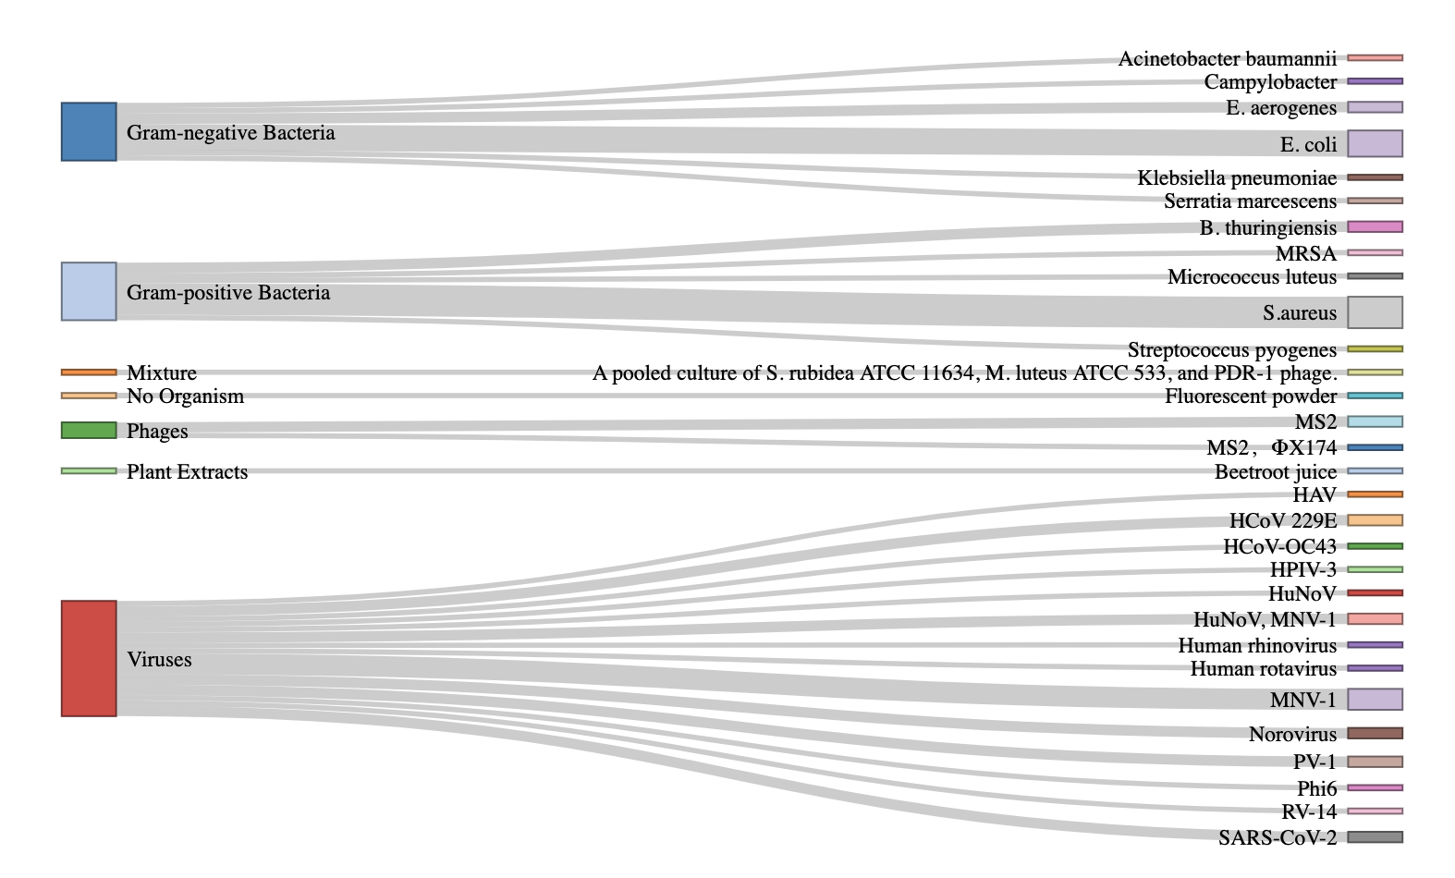
Organism Type
Contaminant

Slide 7
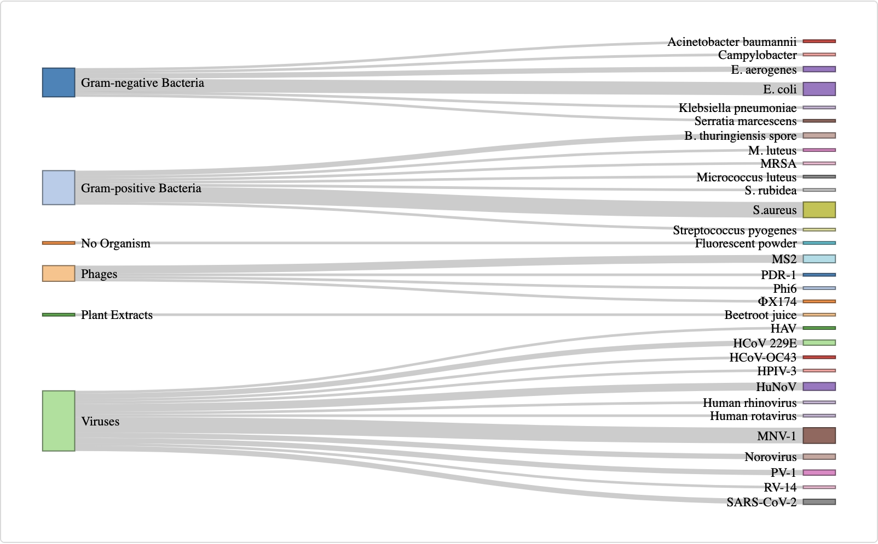
Organism Type
Contaminant

Slide 8
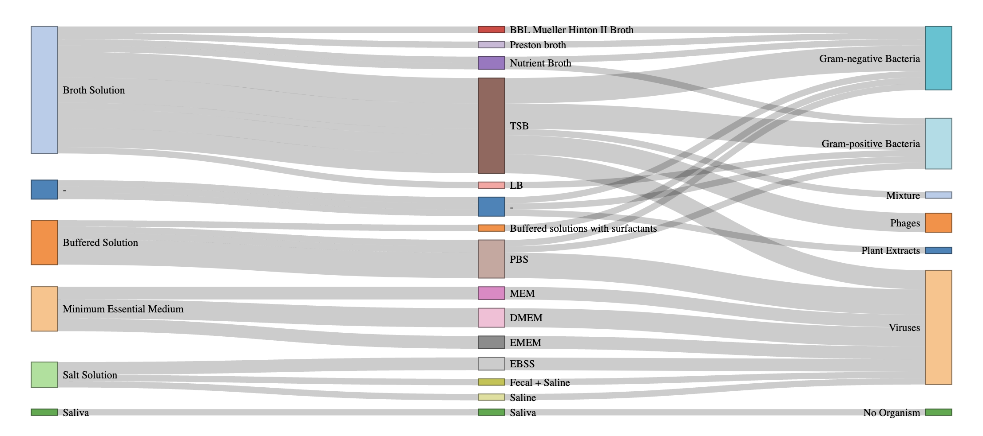
Suspension
Medium
Organism
Type

Slide 9
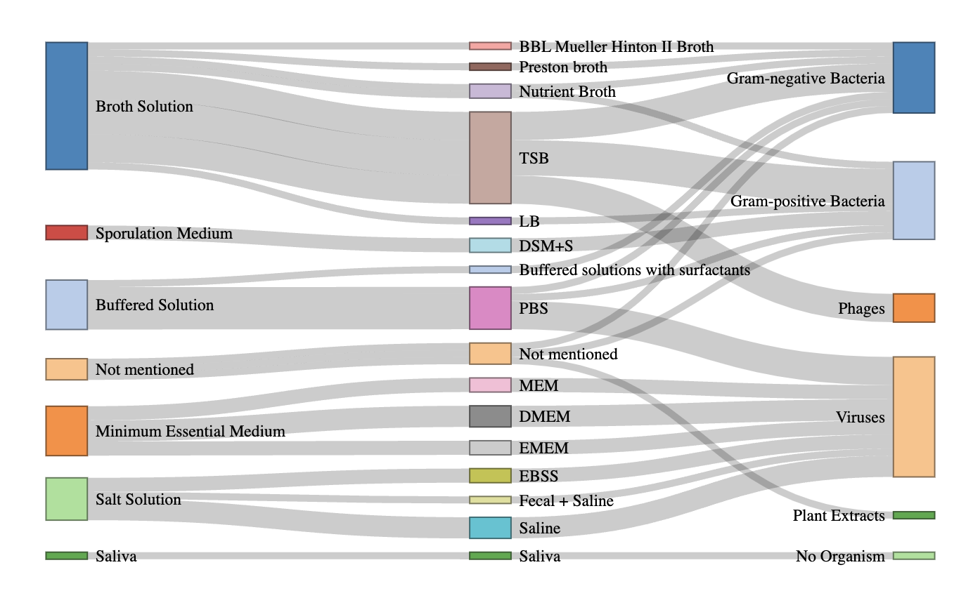
Suspension
Medium
Organism
Type

Slide 10
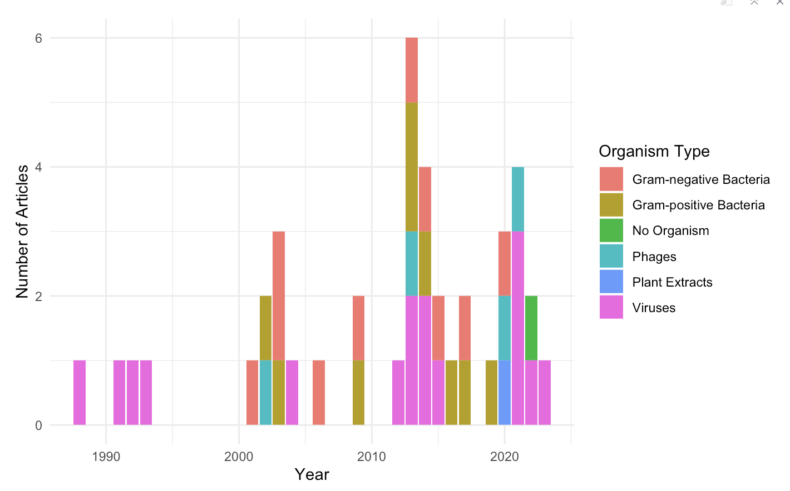



Slide 11
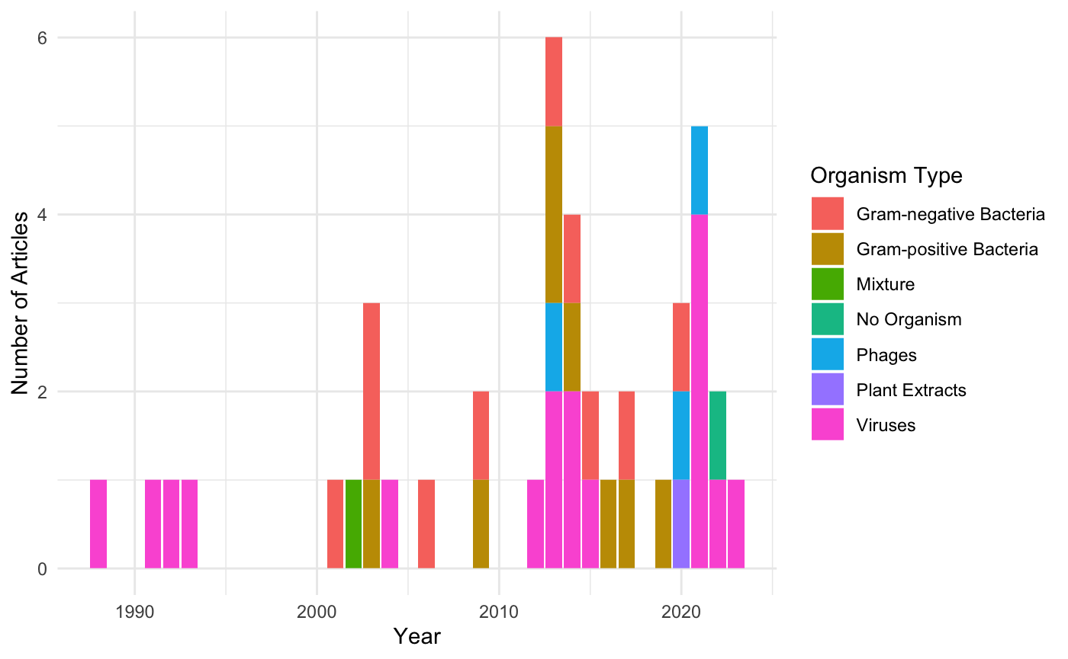

Slide 12
